Slide 1
Border Gateway Protocol
is the only interdomain routing protocol used in the Internet today
based on the path-vector algorithm

Slide 2
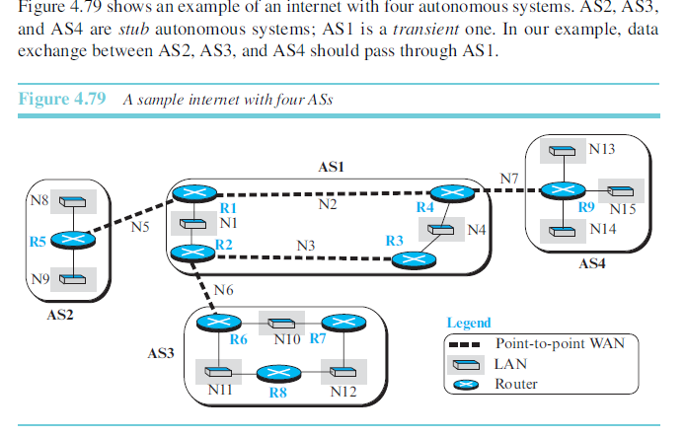
First install a variation of BGP4, called external BGP (eBGP), on each border router
install the second variation of BGP, called internal BGP (iBGP), on all routers
Each router in each AS knows how to reach a network that is in its own AS, but it does not know how to reach a network in another AS.

Slide 3
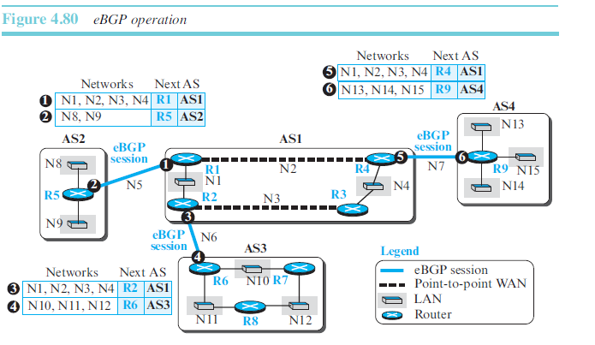
Operation of External BGP
BGP protocol is a kind of point-to-point protocol.
The two routers that run the BGP processes are called BGP peers or BGP speakerscreate.They create TCP connection using the well-known port 179.
Extrenal BGP speakers in our example are:R1-R5, R2-R6, and R4-R9
Each logical connection in BGP peersis referred to as a session.

Slide 4
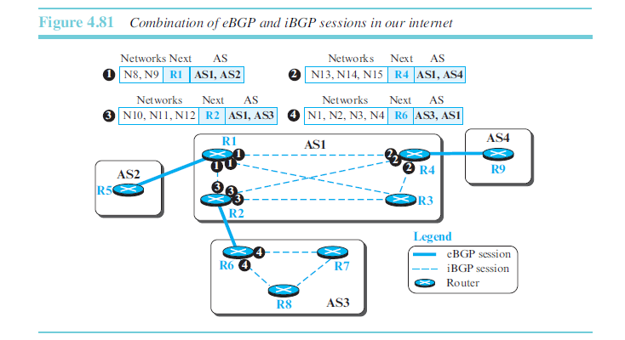
Operation of Internal BGP (iBGP)
it creates a session between any possible pair of routers inside an autonomous system
if an AS has only one router, there cannot be an iBGP session.
if there are n routers in an autonomous system, there should be [n × (n − 1) / 2] iBGP sessions in that autonomous system (a fully connected mesh)

Slide 5
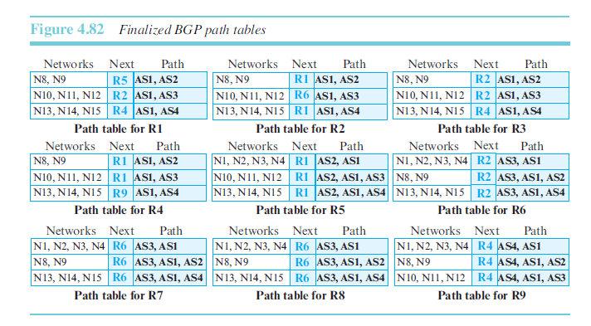
Finalized BGP path tables

Slide 6
Messages
BGP uses four types of messages for communication between the BGP speakers across the ASs and inside an AS:
Open Message. To create a neighborhood relationship, a router running BGP opens a TCP connection with a neighbor and sends an open messageation
Update Message. The update message is the heart of the BGP protocol. It is used by a router to withdraw destinations that have been advertised previously, to announce a route to a new destination, or both
Keepalive Message. The BGP peers that are running exchange keepalive messages regularly (before their hold time expires) to tell each other that they are alive.
Notification. A notification message is sent by a router whenever an error condition is detected or a router wants to close the session

Slide 7
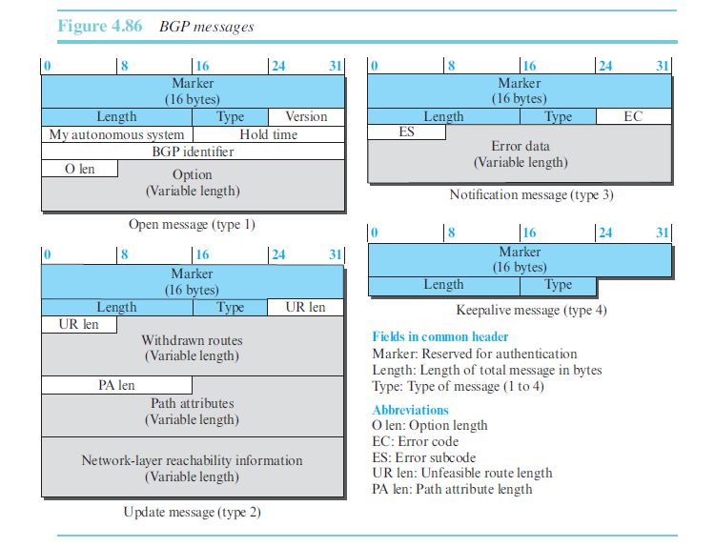

Slide 8
Path Attributes
BGP uses BGP Path Attributes to determine the Best Path to a destination.
BGP Path Attributes divide into two groups. These classes are Well-Known and Optional path attributes. These two groups divide also into two subgroups again.
. A well-known attribute must be recognized by all routers; an optional attribute does not.
A well-known attribute can be mandatory, which means that it must be present in any BGP update message, or discretionary, which means it does not have to be.
An optional attribute can be either transitive, which means it can pass to the next AS, or intransitive, which means it cannot

Slide 9
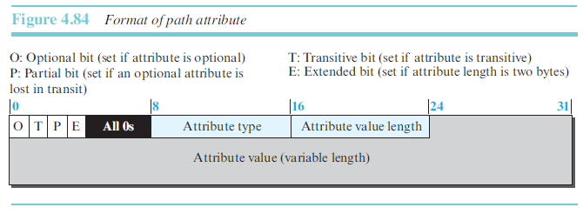
The first byte in each attribute defines the four attribute flags
The next byte defines the type of attributes assigned by ICANN
The attribute value length defines the length ofthe attribute value field

Slide 10
Attribute Types
ORIGIN (type 1). This is a well-known mandatory attribute, which defines the source of the routing information.
AS-PATH (type 2). This is a well-known mandatory attribute, which defines the list of autonomous systems through which the destination can be reached.
NEXT-HOP (type 3). This is a well-known mandatory attribute, which defines the next router to which the data packet should be forwarded.
MULT-EXIT-DISC (type 4). The multiple-exit discriminator is an optional non transitive attribute, which discriminates among multiple exit paths to a destination.
LOCAL-PREF (type 5). The local preference attribute is a well-known discretionary attribute. It is normally set by the administrator, based on the organization policy. The routes the administrator prefers are given a higher local preference value

